Slide 1
Screen recorder

Slide 2
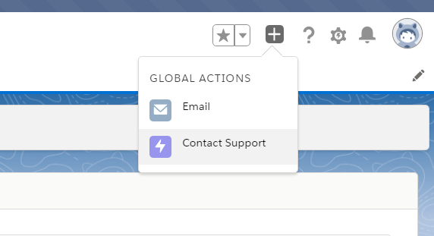
Step 1 – Click on Contact support

Slide 3
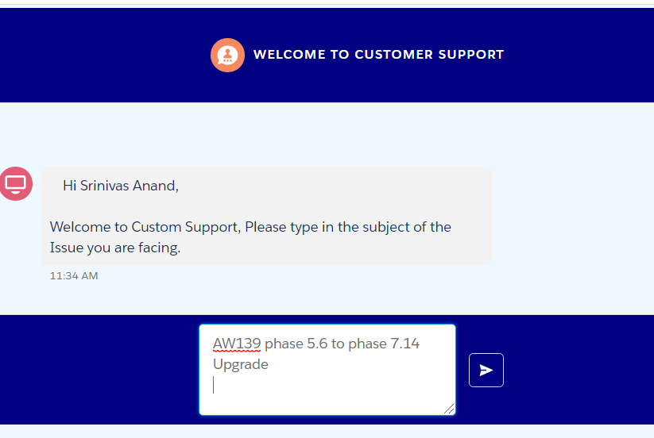
Step 1 – Enter subject

Slide 4
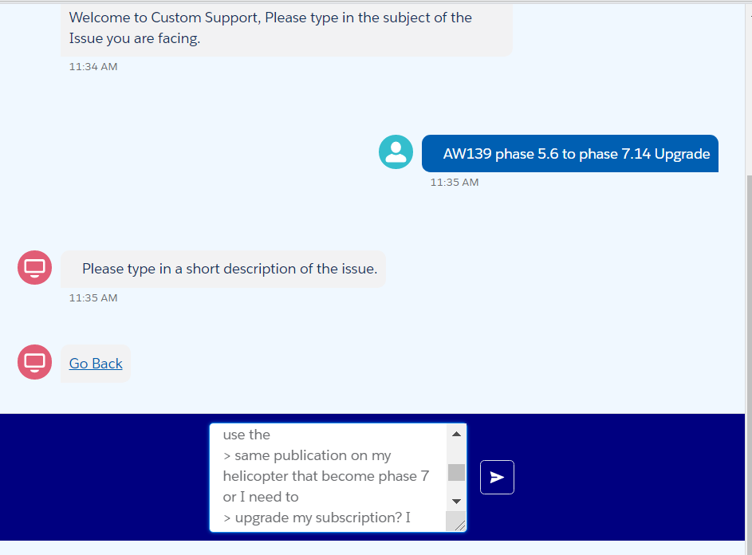
Step 2 – Enter description

Slide 5
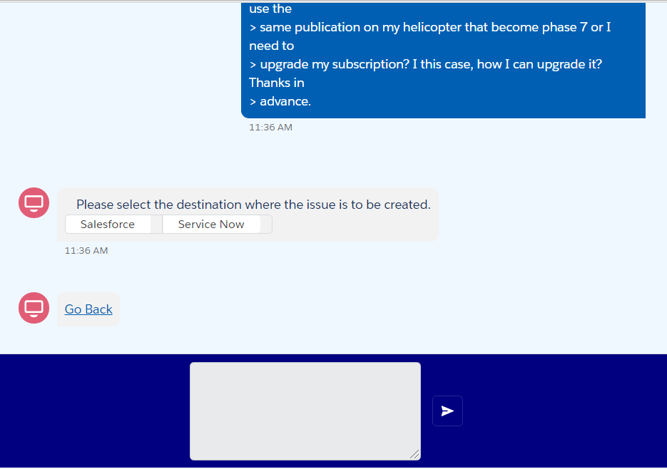
Step 3 – select ticket creation destination

Slide 6
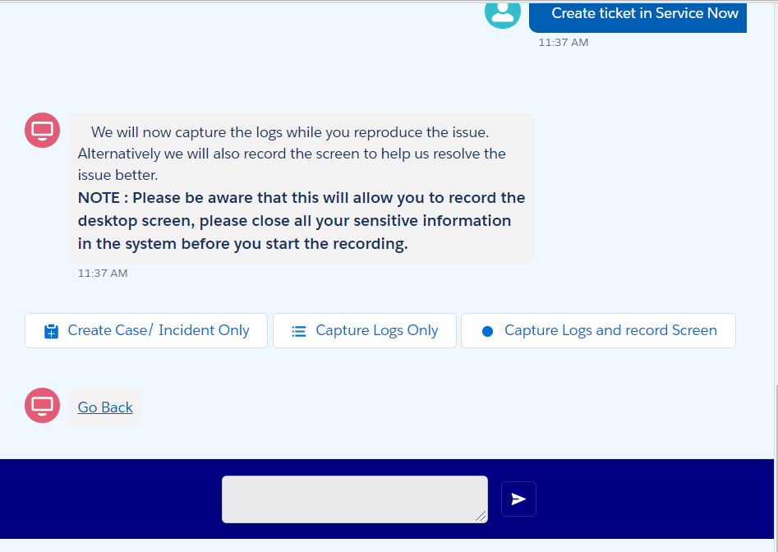
Step 4 – Optionally Record Screen and capture logs
Create case/ incident
Create case/ incident while capturing logs
Create case/ incident while recording screen and capturing logs.

Slide 7
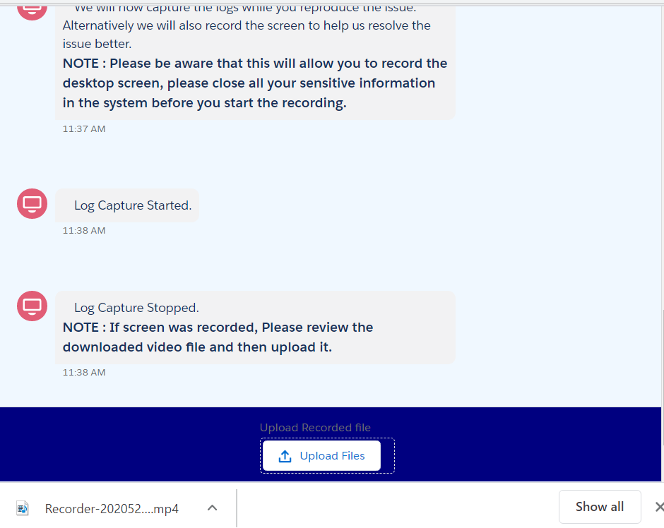
Step 5 – Upload recorded file
If record screen option was selected, the recorded video will get downloaded in the desktop.
Review the video and upload it back using the upload file button.

Slide 8
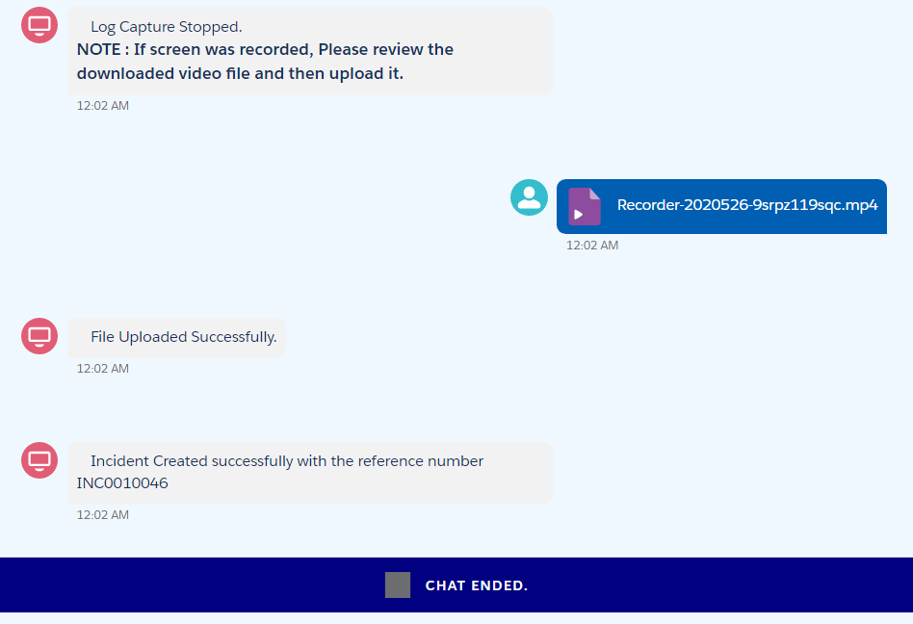
Step 6 – ticket created

Slide 9
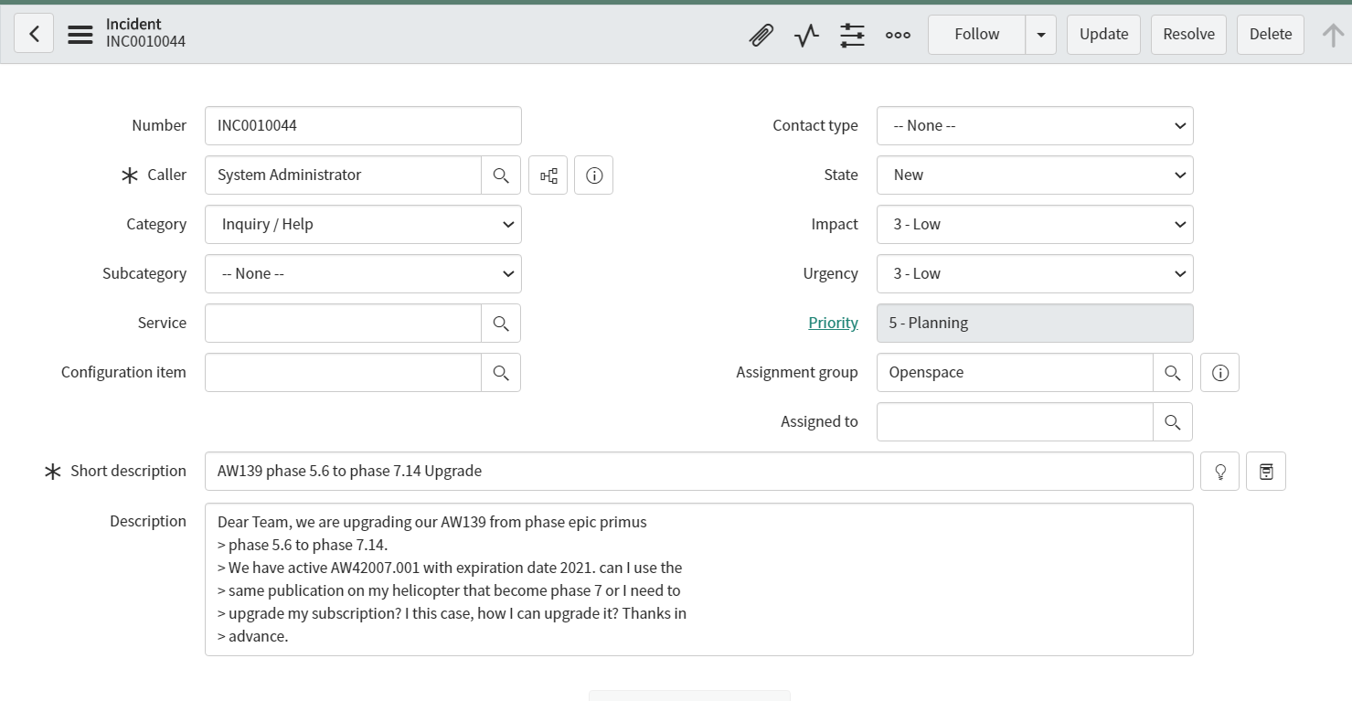
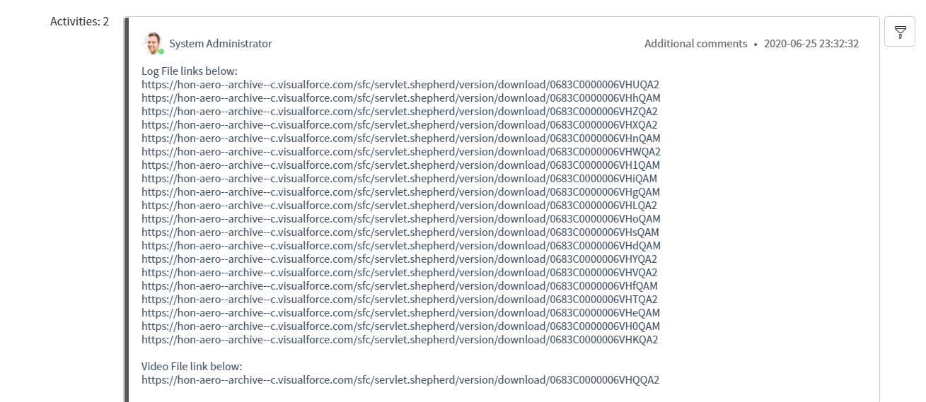
Ticket in Service Now with file links

Slide 10
Thank you

